Slide 1
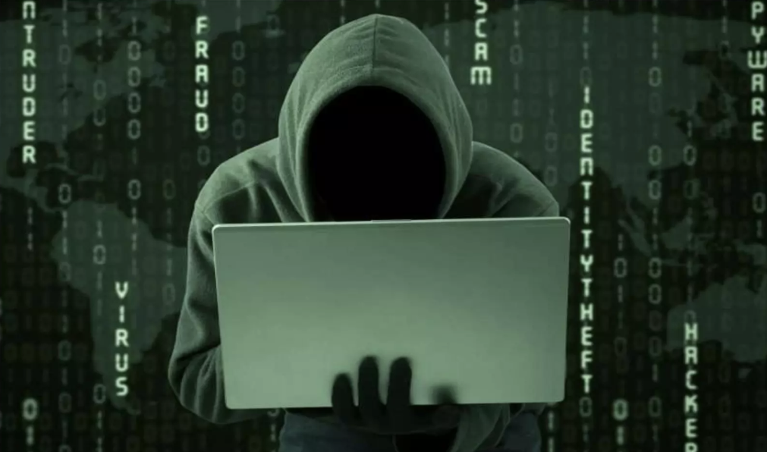
Module 3: Advanced Threat Intelligence
(Threat Analysis, Hunting & Proactive Defense)

Slide 2
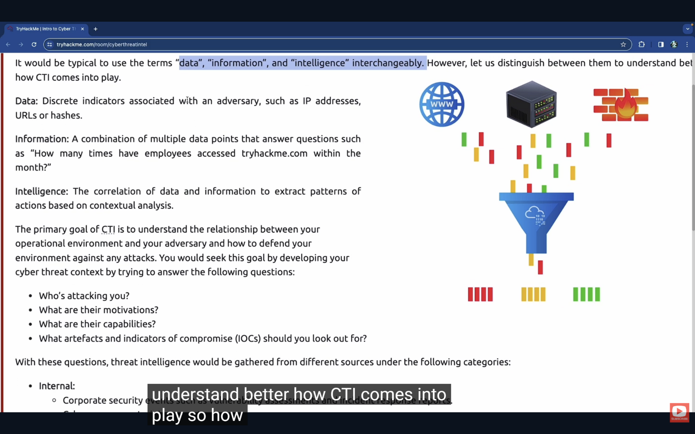
Cyber Threat Intelligence
Cyber Threat mean damaging the data, mobile, and bank account online. Like fake Bank calls, fuzzy websites, email with virus. These damages change everyday.
Threat Intelligence is evidence-based knowledge about:
  Threat actors
  Attack methods
Cyber Threat Intelligence (CTI) is also called Threat
Intelligence.
CTI can be defined as evidence-based knowledge about adversaries, including their indicators, tactics, motivations, and actionable advice against them.
Understand the method of attackers.

Slide 3
Cyber Threat Intelligence
CTI find hidden threat.
CTI is a pre-knowledge gain about danger. Like who doing this and how.
It’s not reactive, it’s a pre-active.
By knowing early, we can protect ourself.
Like by whether forecasting, we can know about cyclone.
These can be utilized to protect critical assets and inform cyber security teams and management business decisions.
Used to make informed security decisions.
It’s not only for IT; it also help in business and decision of cyber security.

Slide 4
Cyber Threat Intelligence
The primary goal of CTI is to understand the relationship between your operational environment and your adversary and how to defend your environment against any attacks.
You would seek this goal by developing your cyber threat context by trying to answer the following questions:
  Who's attacking you?
  What are their motivations?
  What are their capabilities?
  What artefacts and indicators of compromise (IOCs) should you look out for?

Slide 5
Cyber Threat Intelligence
It would be typical to use the terms "data", "information", and "intelligence" interchangeably. However, need to distinguish between them to understand better how CTI comes into play.
Data: Discrete indicators associated with an adversary, such as IP addresses, URLs or hashes.
Information: a combination of multiple data points that answer questions such as "How many times have employees accessed google.com within the month?".
Intelligence: The correlation of data and information to extract patterns of actions based on contextual analysis.

Slide 6
Security Tips
1) Don't believe on bank call or SMS
2) Don't share OTP
3) Share less information on social media.
4) Antivirus in mobile.
5) Don't click on unknown link.
SIEM: Security Information & Event Manager.

Slide 7
Threat Intelligence Sources
With the discussed questions, threat intelligence would be gathered from different sources under the following categories:
Internal
External
Community

Slide 8
Threat Intelligence Sources
1. Internal: Corporate security events such as vulnerability assessments and incident response reports.
  Cyber awareness training reports.
  System logs and events.
  Logs
  Alerts
  Incident reports
Sources of threat intelligence
  Pentest
  vuln assess
  IR report
  logs
  training

Slide 9
Threat Intelligence Sources
2. External: Threat intel feeds (Commercial & Open-Source)
Online marketplaces.
Public sources include government data, publications, social media, financial and industrial assessments.
Open-source intelligence (OSINT)
Vendor reports
ISACs
CERT advisories
No dark web usage.
Sources of threat intelligence
1. Public source
2. Feeds

Slide 10
Threat Intelligence Sources
3. Community:
Open web forums.
Dark web communities for cyber criminals
Sources of threat intelligence
1. Forms
2. Dark web forums

Slide 11
Threat Intelligence Classifications
Threat Intel is geared towards understanding the relationship between your operational environment and your adversary.
With this in mind, we can break down threat intel into the following classifications:
1. Strategic Intelligence
2. Tactical Intelligence
3. Operational Intelligence
4. Technical Intelligence

Slide 12
Threat Intelligence Classifications
Strategic Threat Intelligence (Strategic Intel):
High-level intel that looks into the organization's threat landscape and maps out the risk area based on trends, patterns and emerging threats that may impact business decisions.
This is top level of knowledge. CIGO, CIO, CEO look at this.
This attack happen for geopolitical event like attach with voting or war by this company can plan for long time goal.
like risk in different countries or Where plan cyber investment.
High-level trends
Business risk

Slide 13
Threat Intelligence Classifications
2. Tactical threat Intelligence (Tactical Intel):
Assesses adversaries' tactics, techniques, and procedures (TTPs). This intel can strengthen security controls and address vulnerabilities through real-time investigations.
Basic knowledge like danger IP, virus in file, URL of fake websites, machine can read it fast & put it into automated systems, but these knowledge get older soon as hacker try to change IP always.
TTPs (Tactics, Techniques, Procedures)
MITRE ATTACK mapping

Slide 14
Threat Intelligence Classifications
3. Operational Threat Intelligence (Operational Intel):
Looks into an adversary's specific motives and intent to perform an attack.
Security teams may use this intel to understand the critical assets available in the organization (people, processes and technologies) that may be targeted.
who is the attacker.
what he/she wants, how attack perform by them like a group tries one type of trick to attack on banking app then operation data shows this trend.
This is performed by human by analysis not by only machine.
Ongoing campaigns
Adversary intent

Slide 15
Threat Intelligence Classifications
4. Technical Intelligence (Technical Intel):
Look into evidence and artefacts of attack used by an adversary.
Incident response teams can use this intel to create a baseline attack surface to analyze and develop defense mechanisms.
IPs, domains, hashes (IoCs)

Slide 16
Quiz Time
What does CTI stand for?
Ans: Cyber Threat Intelligence
IP addresses, Hashes and other threat artefacts would be found under which Threat Intelligence classifications?
Ans: Technical intel

Slide 17
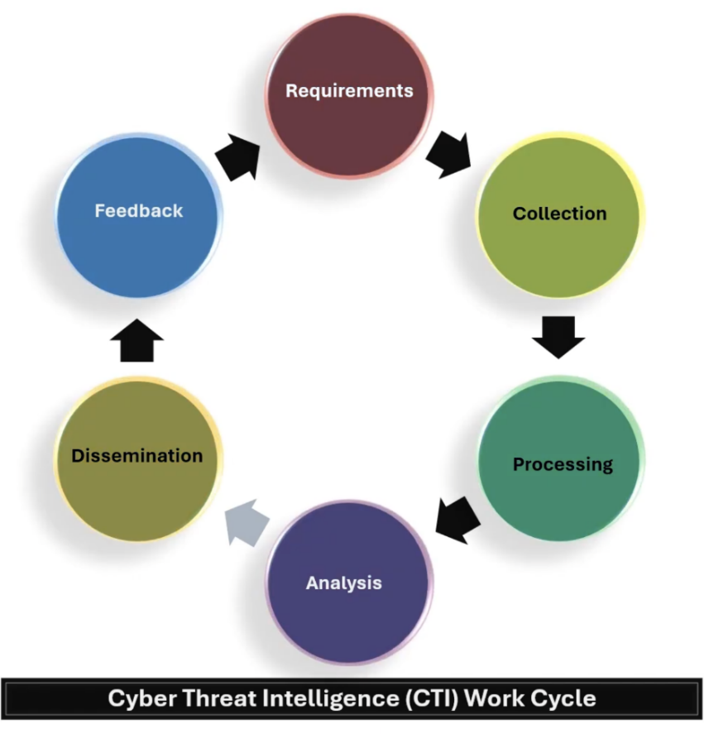
Cyber Threat Intelligence Lifecycle
Threat intel is obtained from a data-churning process.
It transforms raw data into contextualized and action-oriented insights geared towards triaging security incidents.
The transformational process follows a six-phase cycle:
1. Requirement/Planning
2. Collection
3. Processing
4. Analysis
5. Dissemination
6. Feedback
Mapped to: Incident Response, SOC workflows

Slide 18
Cyber Threat Intelligence Lifecycle
Requirement/Planning: what need to know (Who is attacker,
How long this attack).
2) Collection: Log, Social media, forums etc.
3) Processing: Row data -> Information
4) Analysis: Analyze data & Gain meaningful insights.
5) Dissemination: Report making & Deliver to connect
persons. like tech details for technical team. High level
reports for management.
6) Feedback: Information is helpful or other information is required.

Slide 19
Cyber Threat Intelligence Lifecycle
1. Planning and Direction: Objective, Goals
Every threat intel program requires to have objective and goals defined, involving identifying the following parameters:
Information assets and business processes that require defending.
Potential impact to be experienced on losing the assets or through process interruptions.
Sources of data and intel to be used towards protection.
Tools and resources that are required to defend the assets.
This phase also allows security analysts to pose questions related to investigating incidents.
  Assets
  Risks
  Sources
  Tools

Slide 20
Cyber Threat Intelligence Lifecycle
2. Collection: Data
Once objectives have been defined, security analysts will gather the required data to address them.
Analysts will do this by using commercial, private and other source resources available.
Due to the volume of data analysts usually face, it is recommended to automate this phase to provide time for triaging incidents.

Slide 21
Cyber Threat Intelligence Lifecycle
3. Processing:
Raw logs, vulnerability information, malware and network traffic usually come in different formats and may be disconnected when used to investigate an incident.
This phase ensures that the data is extracted, sorted, organized, correlated with appropriate tags and presented visually in a usable and understandable format to the analysts.
SIEMs are valuable tools for achieving this and allow quick parsing of data.
logs
reports SIEM

Slide 22
Cyber Threat Intelligence Lifecycle
4. Analysis: Insights
Once the information aggregation is complete, security analysts must derive insights. Decisions to be made may involve:
Investigating a potential threat through uncovering indicators and attack patterns.
Defining an action plan to avert an attack and defend the infrastructure.
Strengthening security controls or justifying investment for additional resources.
Action plan
Security profile

Slide 23
Cyber Threat Intelligence Lifecycle
5. Dissemination
Different organizational stakeholders will consume the intelligence in varying languages and formats.
For example, C-suite members will require a concise report covering trends in adversary actives, financial implications and strategic recommendations.
At the same time, analysts will more likely inform the technical team about the threat IOCs (Indication of compromise), adversary TTPs (Tactic techniques and procedures) and tactical action plans.
presentation stage
Stake holders

Slide 24
Cyber Threat Intelligence Lifecycle
6. Feedback: Responses
The final phase covers the most crucial part, as analysts rely one the responses provided by stakeholders to improve the threat intelligence process and implementation of security controls.
Feedback should be regular interaction between teams to keep the Lifecyle working.

Slide 25
CTI Framework
Threat intelligence framework collect TTPs and categorize them according to
Threat Group
Kill Chain Phase
Tactic
Objective/Goal
Structure or guidance for the use of Threat Intelligence.
MITRE-ATT&CK- TTPs
Cyber Kill chain

Slide 26
CTI Framework
Some of these frameworks are:
MITRE-ATT&CK- - https://attack.mitre.org
TIBER (Threat Intelligence-based Ethical Red Teaming)
https://www.ecb.Europa.eu/pub/pdf/other/ecb.tiber_eu_framework.en.pdf
OST Map- https://www.intezer.com/ost-map
TAXII- https://oasis-open.github.io/cti-documentation/taxii/intro
STIX- https://oasis-open.github.io/cti-documentation/stix/intro

Slide 27
Quiz Time
At which phase of the CTI lifecycle is data converted into usable formats though sorting, organizing, correlation and presentation?
Ans: Processing
During which phase do security analysts get the chance do define the questions to investigate incidents?
Ans: Direction

Slide 28
Thankyou

